Slide 1
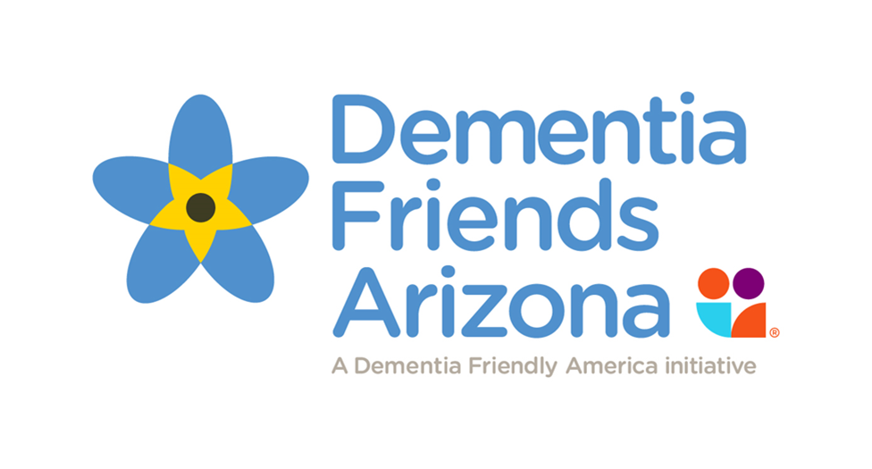




Thank you for joining us!
The Dementia Friends Information Session will begin shortly.
Session will last 1 hour
Have a pen & paper handy
Feel free to use the chat box at any time
Be ready to participate!

Slide 2
Dementia Friends
Information Session
Changing the Way People Think,
Act and Talk About Dementia
Adrian Keller, Policy Fellow
Office of Mayor Kate Gallego
Jan Dougherty, MS, RN, FAAN
President, TravALZ/
Volunteer Dementia Friends Tempe
© 2017
Notes:
BOTH (Introductions)

Slide 3
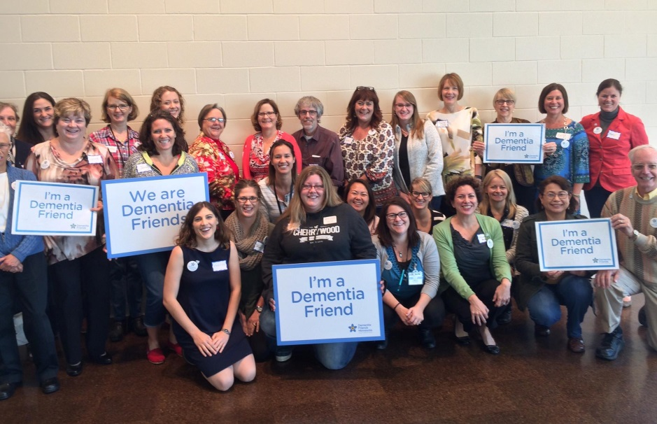
What is Dementia Friends?
Developed by the Alzheimer’s Society in the United Kingdom
Now in the United States
Help community members:
  Understand what dementia is
  How dementia affects people
  How we can make a difference in the lives of people with dementia
Notes:
ADRIAN

Slide 4
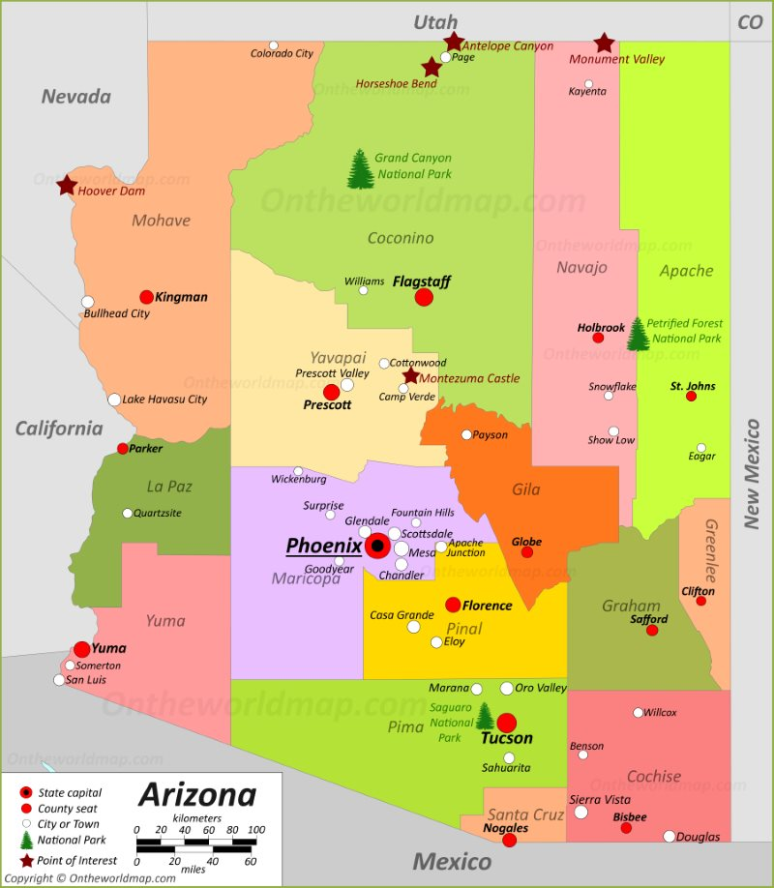
Dementia Friendly Arizona
Making Arizona Dementia Friendly
One Community at a Time…..
1. Tempe, Arizona
2. Surprise, Arizona
3. Scottsdale, Arizona
4. Phoenix, Arizona
5. Mesa, Arizona
6. Glendale, Arizona
Dementia Friendly America: www.dfamerica.org
Notes:
ADRIAN

Slide 5
Relevant Statistics
Over 6 million Americans have Alzheimer’s Disease
150,000 Arizonans aged 65+ live with disease
262,000 AZ family caregivers are affected, with 53.5% reporting chronic health conditions themselves
Projected increase in Arizona cases: 33% by 2025
  Fastest growing state in the nation with 200,000 cases expected
Impact of COVID-19: Alzheimer’s and dementia deaths have increased during the pandemic. Arizona: 30.4% higher with 1,532 more deaths in 2020 than had been projected.
According to the Alzheimer’s Association:
  10% of 60+ persons have dementia
  50% of 85+ have dementia
  Discrimination is reported to be a barrier to Alzheimer’s and dementia care*
  *2021 Alzheimer’s Disease Facts and Figures, Alzheimer’s Association, ALZ.org
Notes:
ADRIAN

Slide 6
Thoughts About Dementia
What is one word that comes to mind when you hear the word
“dementia”?
______________________
Notes:
JAN

Slide 7
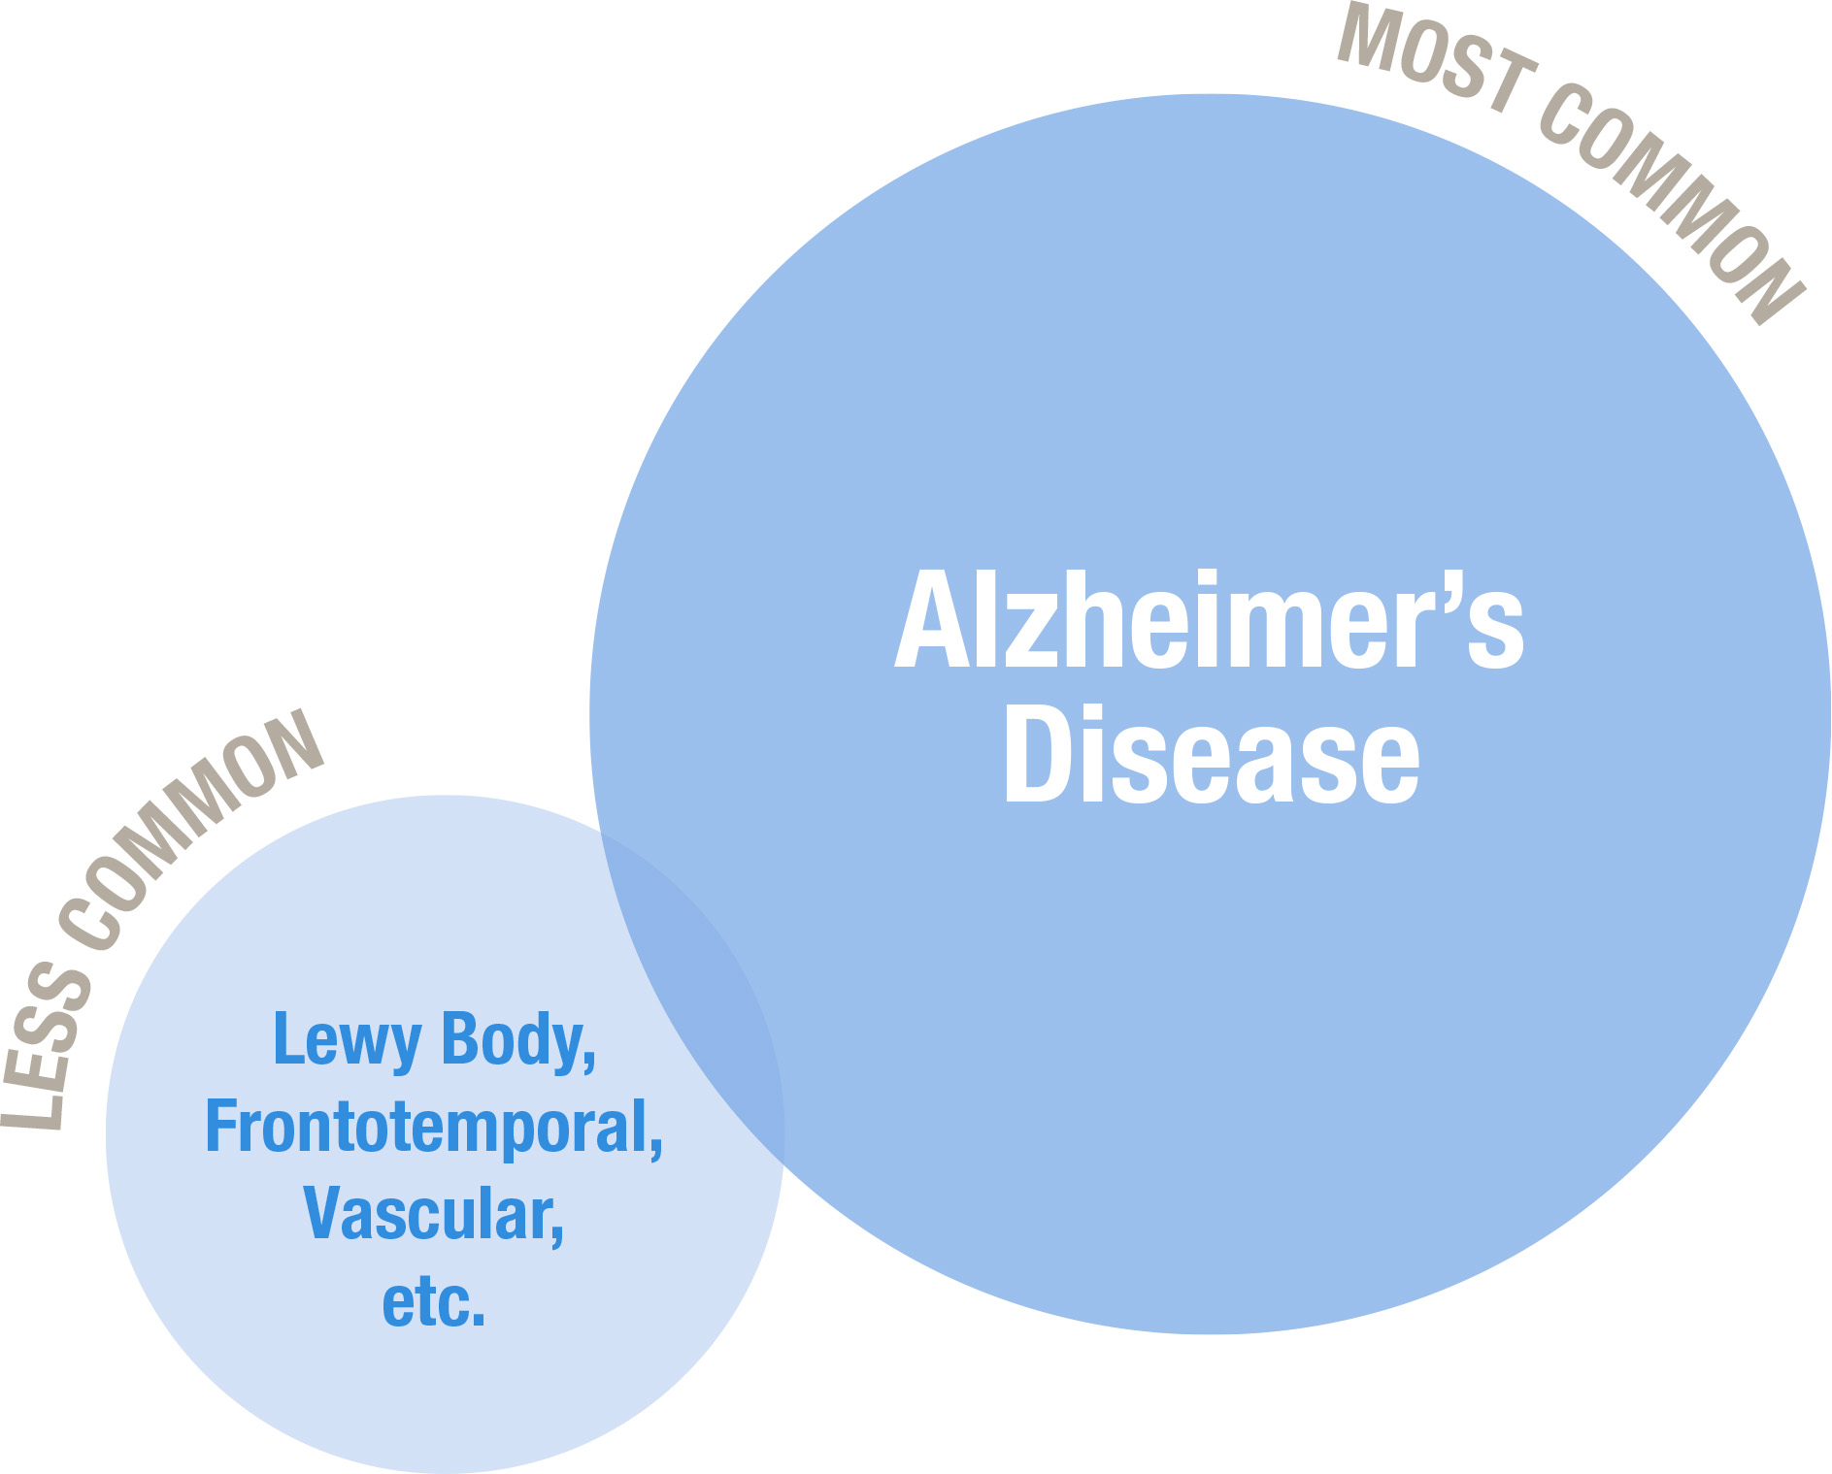
Types of Dementia
Notes:
JAN

Slide 8
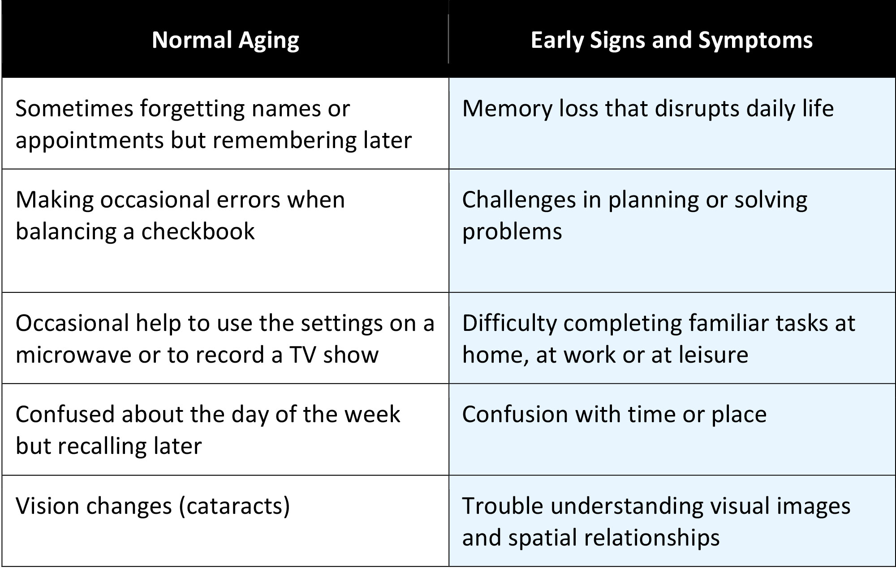
Normal Aging vs. Alzheimer’s
Notes:
JAN

Slide 9
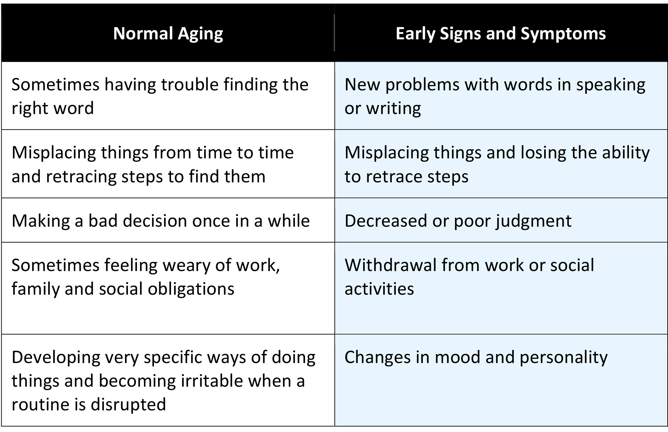
Normal Aging vs. Alzheimer’s
Notes:
JAN

Slide 10
Five Key Messages
Dementia is not a normal part of aging.
Dementia is caused by diseases of the brain.
Dementia is not just about having memory problems.
It is possible to have a good quality of life with dementia.
There’s more to the person than the dementia.
Notes:
JAN

Slide 11
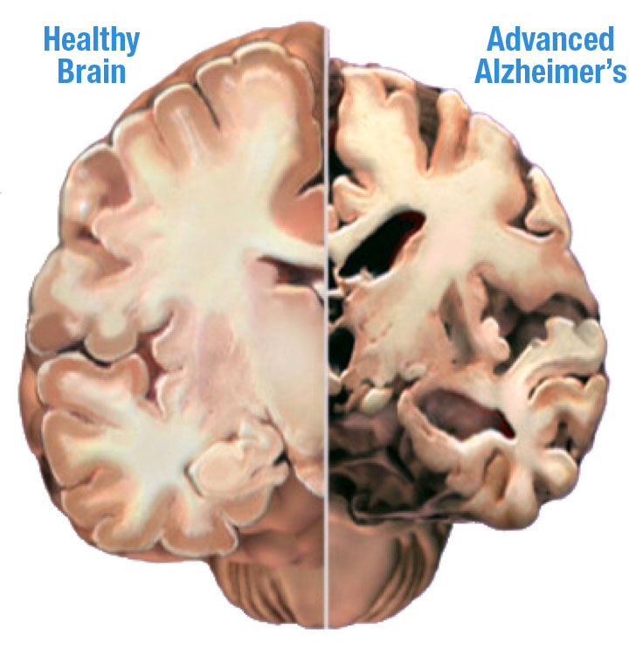
Dementia and the Brain
Notes:
JAN

Slide 12
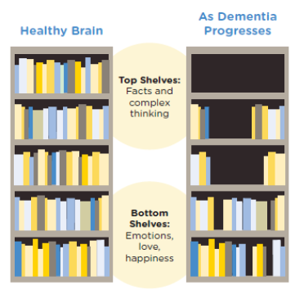
Bookcase Story
Notes:
JAN

