Slide 1
Dementia Friendly Libraries and Airports
(covering other
non-visible disabilities)
Marjorie Doyle
Reference Librarian (ret.)
liaison with Dementia Friendly Missoula and Dementia Friendly Airports Working Group
11/14/2023
Notes:
I am a reference librarian and have worked in and with special, academic, and public libraries since the mid-1970s working with people across all ages. I have done training sessions for librarians in Montana and staff at Missoula Public Library on services to seniors and to those living with dementia. You may be familiar with the annotated bibliography that I created on books for children and young adults about Alzheimer’s ( a resource on your website).

Slide 2
Missoula Public Library
American Library Assn. - interest groups, continuing education, programs
“equity, diversity, inclusion”
Supporting People to Live Well with Dementia: A Guide for Library Services
Patrons with Alzheimer’s and Related Dementias
Library Services for Patrons with Alzheimer's/Dementia
Notes:
As the senior outreach librarian at Missoula Public Library I had access to a variety of resources including the American Library Association, which I used to not only learn about programming, collection development for senior populations, and best practices, but also hpw to select materials to support readers with cognitive challenges.
Current MPL services to this population include
Programs – Memory Café – a safe social space for those with dementia and their caregivers (which includes a resource specialist from MAS to provide on-the-spot answers to caregivers) and the Sunflower Lanyard program.
Collections – Assistive reading devices, large print and audio collections, board games, puzzles, Memory Kits: Activity kits for caregivers
Home Library Service - in person library services to residential locations in Missoula

Slide 3
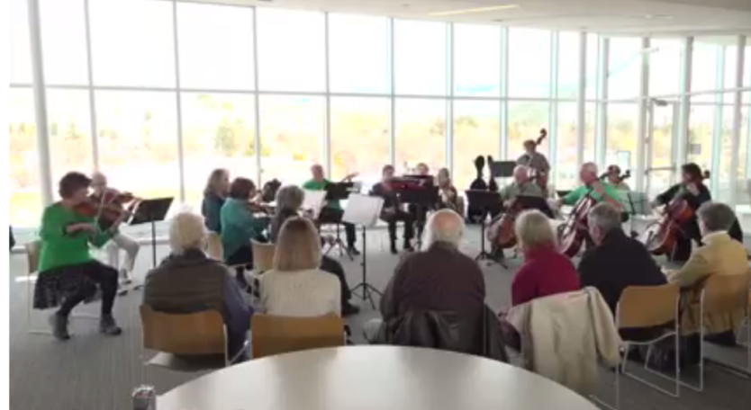
Notes:
MPL recently did a survey of their Memory Café attendees. Their answers helped clarify why programming for this population is important.
What do you enjoy most about attending Memory Café? -- “For me as the caretaker, being with others who are in the same situation. My husband has always had a love of learning so this is a great way to be informed in a comfortable setting.”
Do you think attending Memory Café has had benefits for you or for others with whom you attend? -- “Yes, I can laugh, be with others who are sharing my experiences. We are getting to know each other month by month so I feel much less alone. My husband can’t wait to get here-he gets to socialize with others who understand.”
“I love the opportunity to visit with others who are experiencing what I'm going through. It is a time to share what works and doesn't work with loved ones experiencing memory loss.” “We are so grateful to have a place that is entertaining, accepting and safe to be with others. Understanding means so much.”

Slide 4
Notes:
MPL has become certified as the first library in the US to adopt the Sunflower Lanyard program. Information about this program was made available during the 2022 MLA Tri-conference which included libraries from Montana Library Association (MLA), Pacific Northwest Library Association (PNLA) which covers 4 states 2 provinces, Mountain Plains Library Association (MPLA) which covers 12 states.

Slide 5
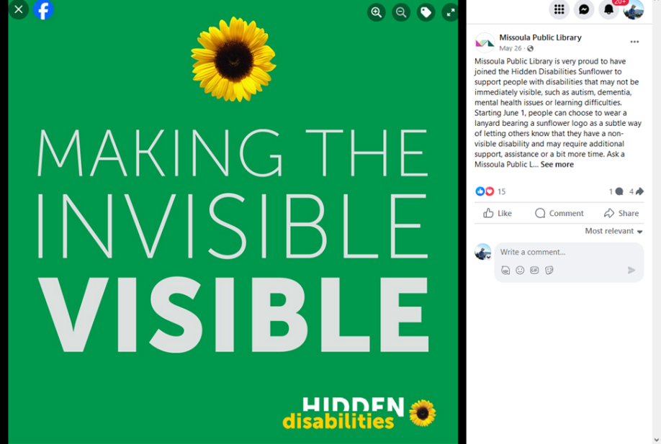

Slide 6
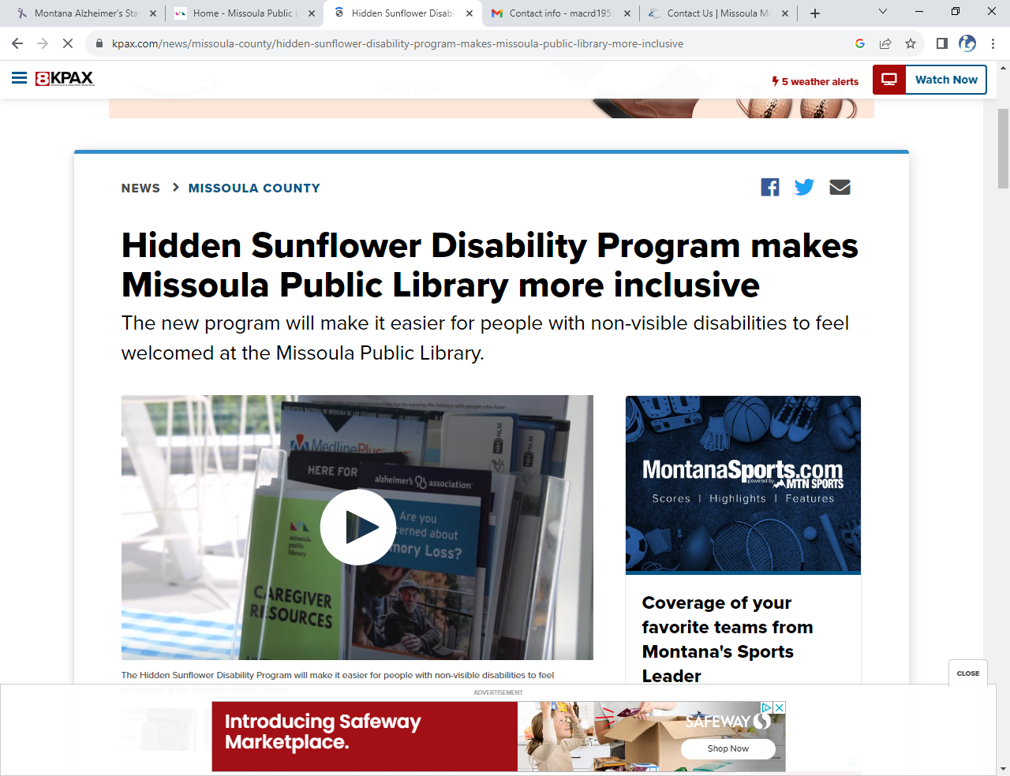
Notes:
KPAX.com news recently did an extensive interview about library programs that highlighted the sunflower lanyard program as well as some of our other outreach programs , including the memory cafe.

Slide 7
Dementia Friendly Airports Working Group
www.dementiafriendlyairports.com/
Introducing the concept to the airport
The new terminal presented the opportunity to make sure the building met appropriate guidelines:
Visual: Reflectance, pattern, gloss, color, appearance, lighting level
Aural: Noise levels, HVAC noise, privacy, reverberation (liveness), footfall noise, speech,
Thermal: Drafts, stagnant air, humidity, thermal asymmetry
Olfactory: Presence of noticeable smells or odors
as well as the opportunity to introduce staff training possibilities
Notes:
I became a member of the group that is now Dementia Friendly Missoula in 2017 as a result of a conversation about what libraries were doing in the area of services for elders with dementia.
When I heard about the DFAW group I suggested that we contact their leader and see what we could do to encourage the Missoula airport to not only incorporate dementia friendly spaces into their new terminal but to also train their ground employees to better respond to travelers with dementia and their families.
July 2020 I suggested to DFM that we approach the Missoula airport about becoming dementia friendly using info from research on traveling with dementia and info from the DFAWG group. Our airport was in the midst of building their new terminal which presented the opportunity to make sure it met appropriate guidelines: lighting, sound, flooring, reflective surfaces, etc. as well as the opportunity to introduce training for their ground staff. I met with the airport board in
As I told the airport board, training of staff would not only empower their staff to respond appropriately to travelers but would also empower those with non-visible disabilities, like dementia, to have positive travel experiences which, research has shown to have a positive impact on those living with dementia and their families.
At our recent DFAWG meeting, Jan Dougherty, our member from the Phoenix airport shared with us the workshop that she had given at their airport, the result of which was a nice write up in the Alzheimers Assn. newsletter and US News & World report.
Some of the areas of concern that have been covered by the working group include:
Environmental audit of air terminals and parking areas
Establishment/expansion of rehearsal trips for people with dementia and their care partners to become familiar with/desensitized to air travel protocol/site, including security protocol
Establishment of dementia-specific training for airport staff on all levels, including concession staff (wheelchairs and travel carts)
The various environmental areas covered include:
Visual: Reflectance, pattern, gloss, color, appearance, lighting level
Aural: Noise levels, HVAC noise, privacy, reverberation (liveness), footfall noise, speech
Thermal: Drafts, stagnant air, humidity, thermal asymmetry
Olfactory: Presence of noticeable smells or odors

Slide 8
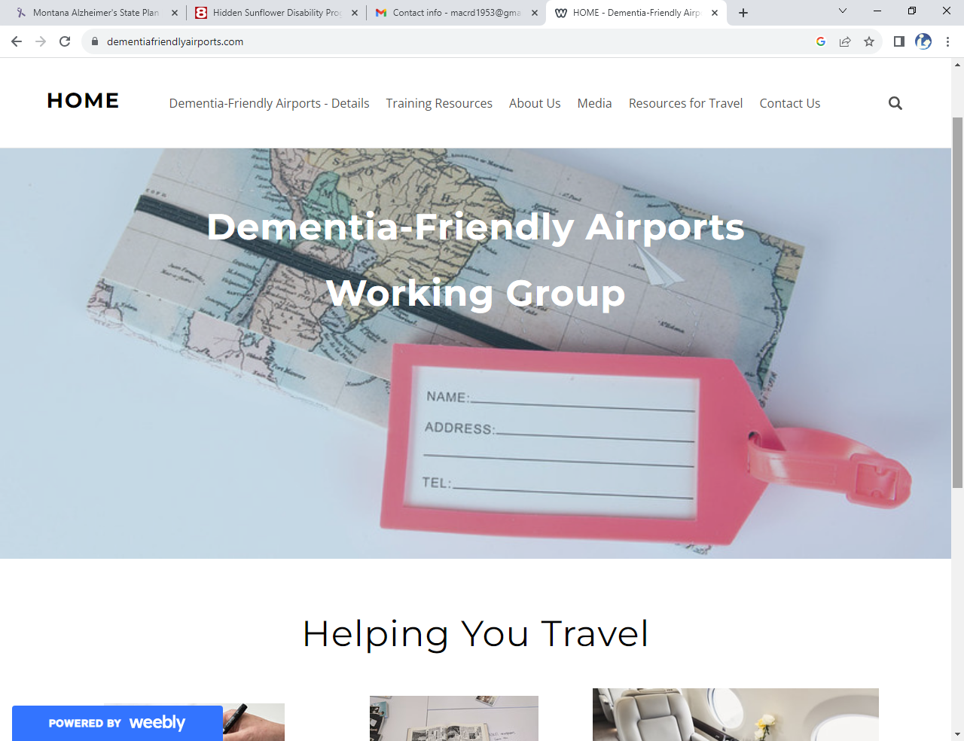
Notes:
Their resources page has a variety of tools for helping travelers plan trips and anticipate problems

Slide 9
406-728-4381
contactus@flymissoula.com
Notes:
The Missoula airport management and their board were very responsive to the recommendations from the airport working group and one of the first things that they did, which was put in place during the COVID pandemic travel restrictions, was create a narrated virtual tour so that families could experience the layout of the airport prior to their flight making the actual trip less stressful. Research shows that a tour of the airport prior to going on a trip is a good way to make travelers more comfortable and decreases anxiety.
With Missoula being a regional airport that has travelers driving an hour or more to initiate their trip this was not often a possibility. This virtual tour creates some familiarity with the airport environment. Guided in-house tours are always available with arrangement made ahead of time for those that can travel to the airport.

Slide 10
Dementia Friendly America
https://www.dfamerica.org/
Toolkits – help define need and identify sectors within the community
Sector Guides - help pinpoint sectors within the community to target with training and information specific to that sector
Resources – include training materials specific to the sector being targeted
Notes:
Several years into my time at Missoula PL I found the resource, Dementia Friendly America . This provided great training tools for me as I broadened the services that the library was providing to seniors living with dementia.
Dementia Friendly America has been around since 2015 and their guides are based on sectors within the community with training materials designed specifically for those sectors. These include but are not limited to airports, libraries, banks, faith communities, etc. I always recommend it to libraies when sharing information or doing trainings.

Slide 11
Sunflower Lanyard
hdsunflower.com
Kulture City
www.kulturecity.org
Notes:
The Sunflower Lanyard international program, begun in 2016 at airports in the UK, includes businesses ranging from retail, travel and tourism, and transport including over 200 airports . Some disabilities, conditions or chronic illnesses are not immediately obvious to others. So, this program focuses on disabilities that are not apparent and covers ADHHD and Alzheimer’s through Tourette Syndrome and Ulcerative Colitis. The Sunflower has been launched at airports on every continent including 81 airports in the US. Training for staff is required and provided as part of the program and the cost to be a participant ranges based on the number of employees.
Kulture City, begun in 2013 and based in Alabama, focuses on venues that see large numbers of people, e.g. airports, zoos, concert halls, and also works with first responder groups to provide training to make responders more comfortable serving those with sensory disabilities. Their focus is sensory inclusion and accessibility and they have over 1800 venues certified across the globe.
Missoula Airport has chosen to offer training from and is certified by both programs. To ensure that airport staff complete the training they have to document their completion to get their access cards that gives them access to staff-only areas within their workplace.

Slide 12
Notes:
Just a few shots from the sunflower webpage

Slide 13
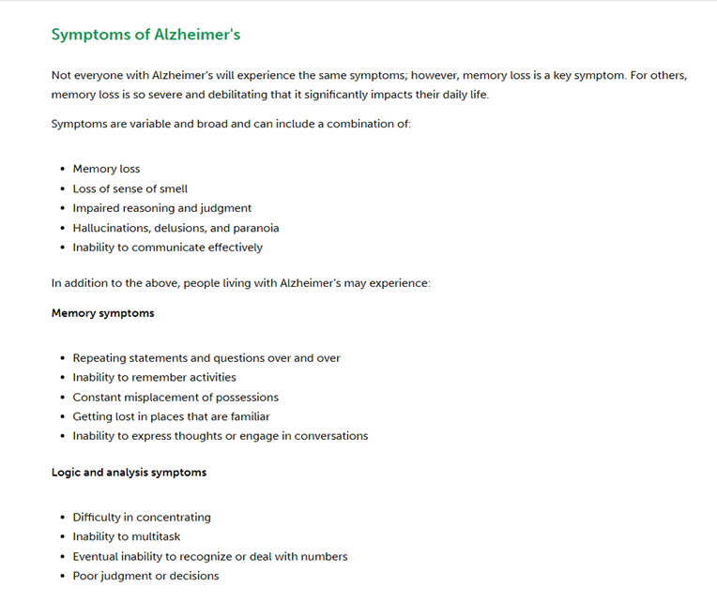

Slide 14
QUESTIONS?

